Slide 1
Digital Divide Index (DDI)
Tao Yuan,Qian Yin,Sihan Bai

Slide 2
DDI
INFA (Infrastructure Access) = NIA * 0.3 + NCD * 0.3 - DNS * 0.05 - UPS * 0.05
SE = AGE65 + POV + LTHS + DIS
DDI (Digital Divide Index) = INFA + SE
Digital Equity Act of 2021
SE (Socio-Economic) = AGE60 + INCAR + VET + DIS + MIN + RURAL + LANG + POV

Slide 3
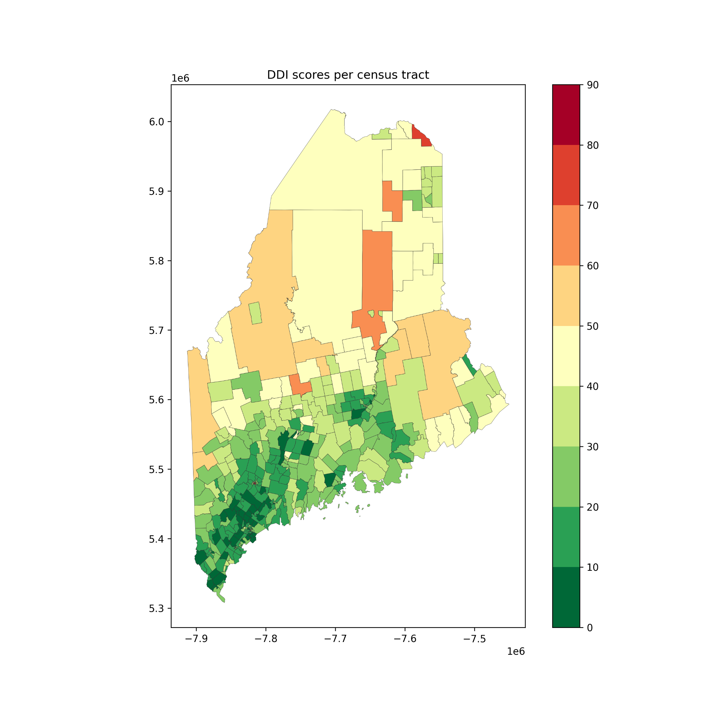
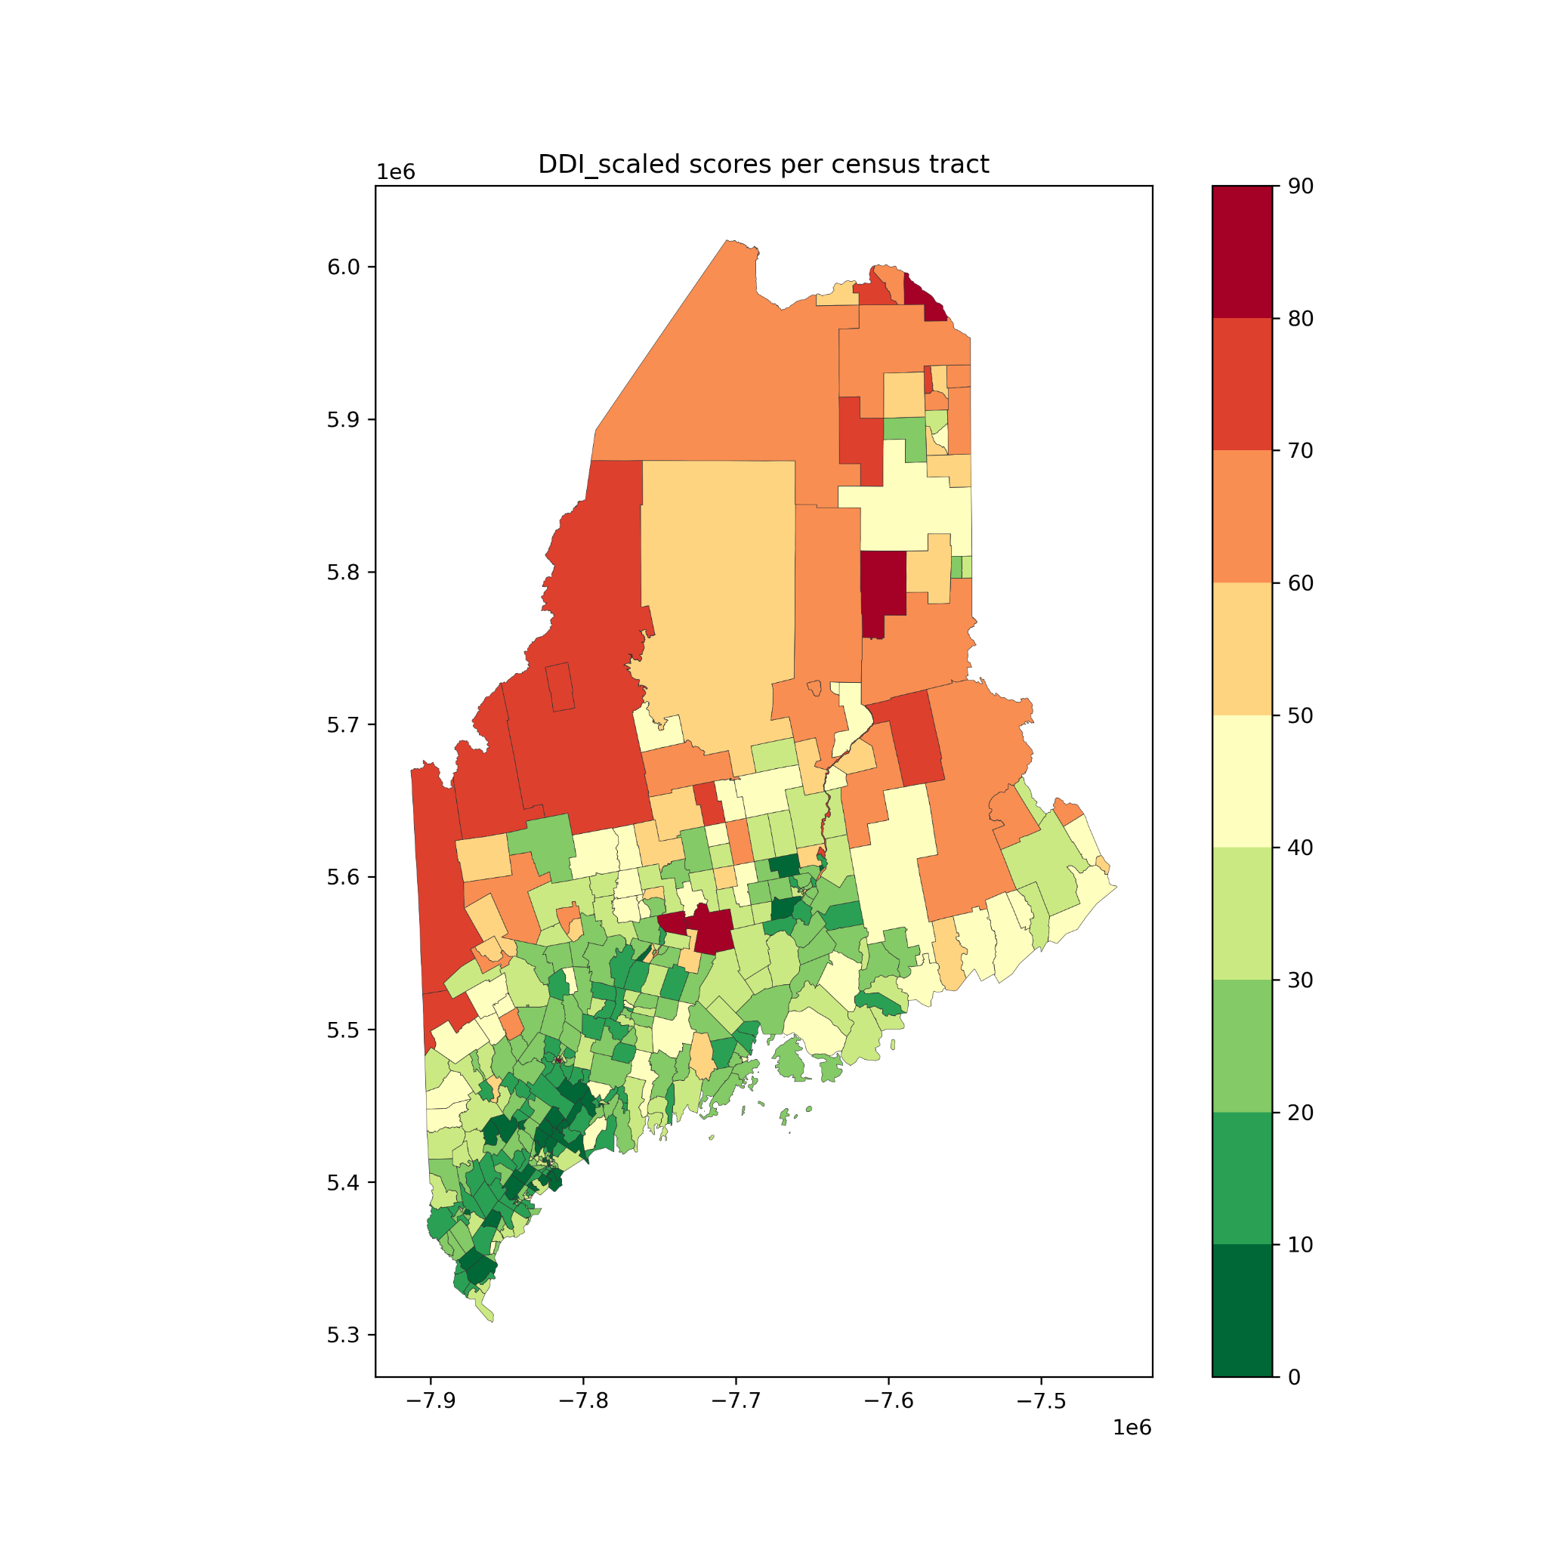
2023 spring
2024 spring
The increasing DDI may be caused by the difference in DDI formula.

Slide 4
INFA
INFA (Infrastructure Access) = NIA * 0.3 + NCD * 0.3 - DNS * 0.05 - UPS * 0.05
* NIA: z-scores of the percent of population with no internet access(NIA)
* NCD: z-scores of the percent of population with no computing devices (NCD)
* DNS: z-scores of the average max download available (DNS)
* UPS: z-scores of the average max upload available (UPS)

Slide 5
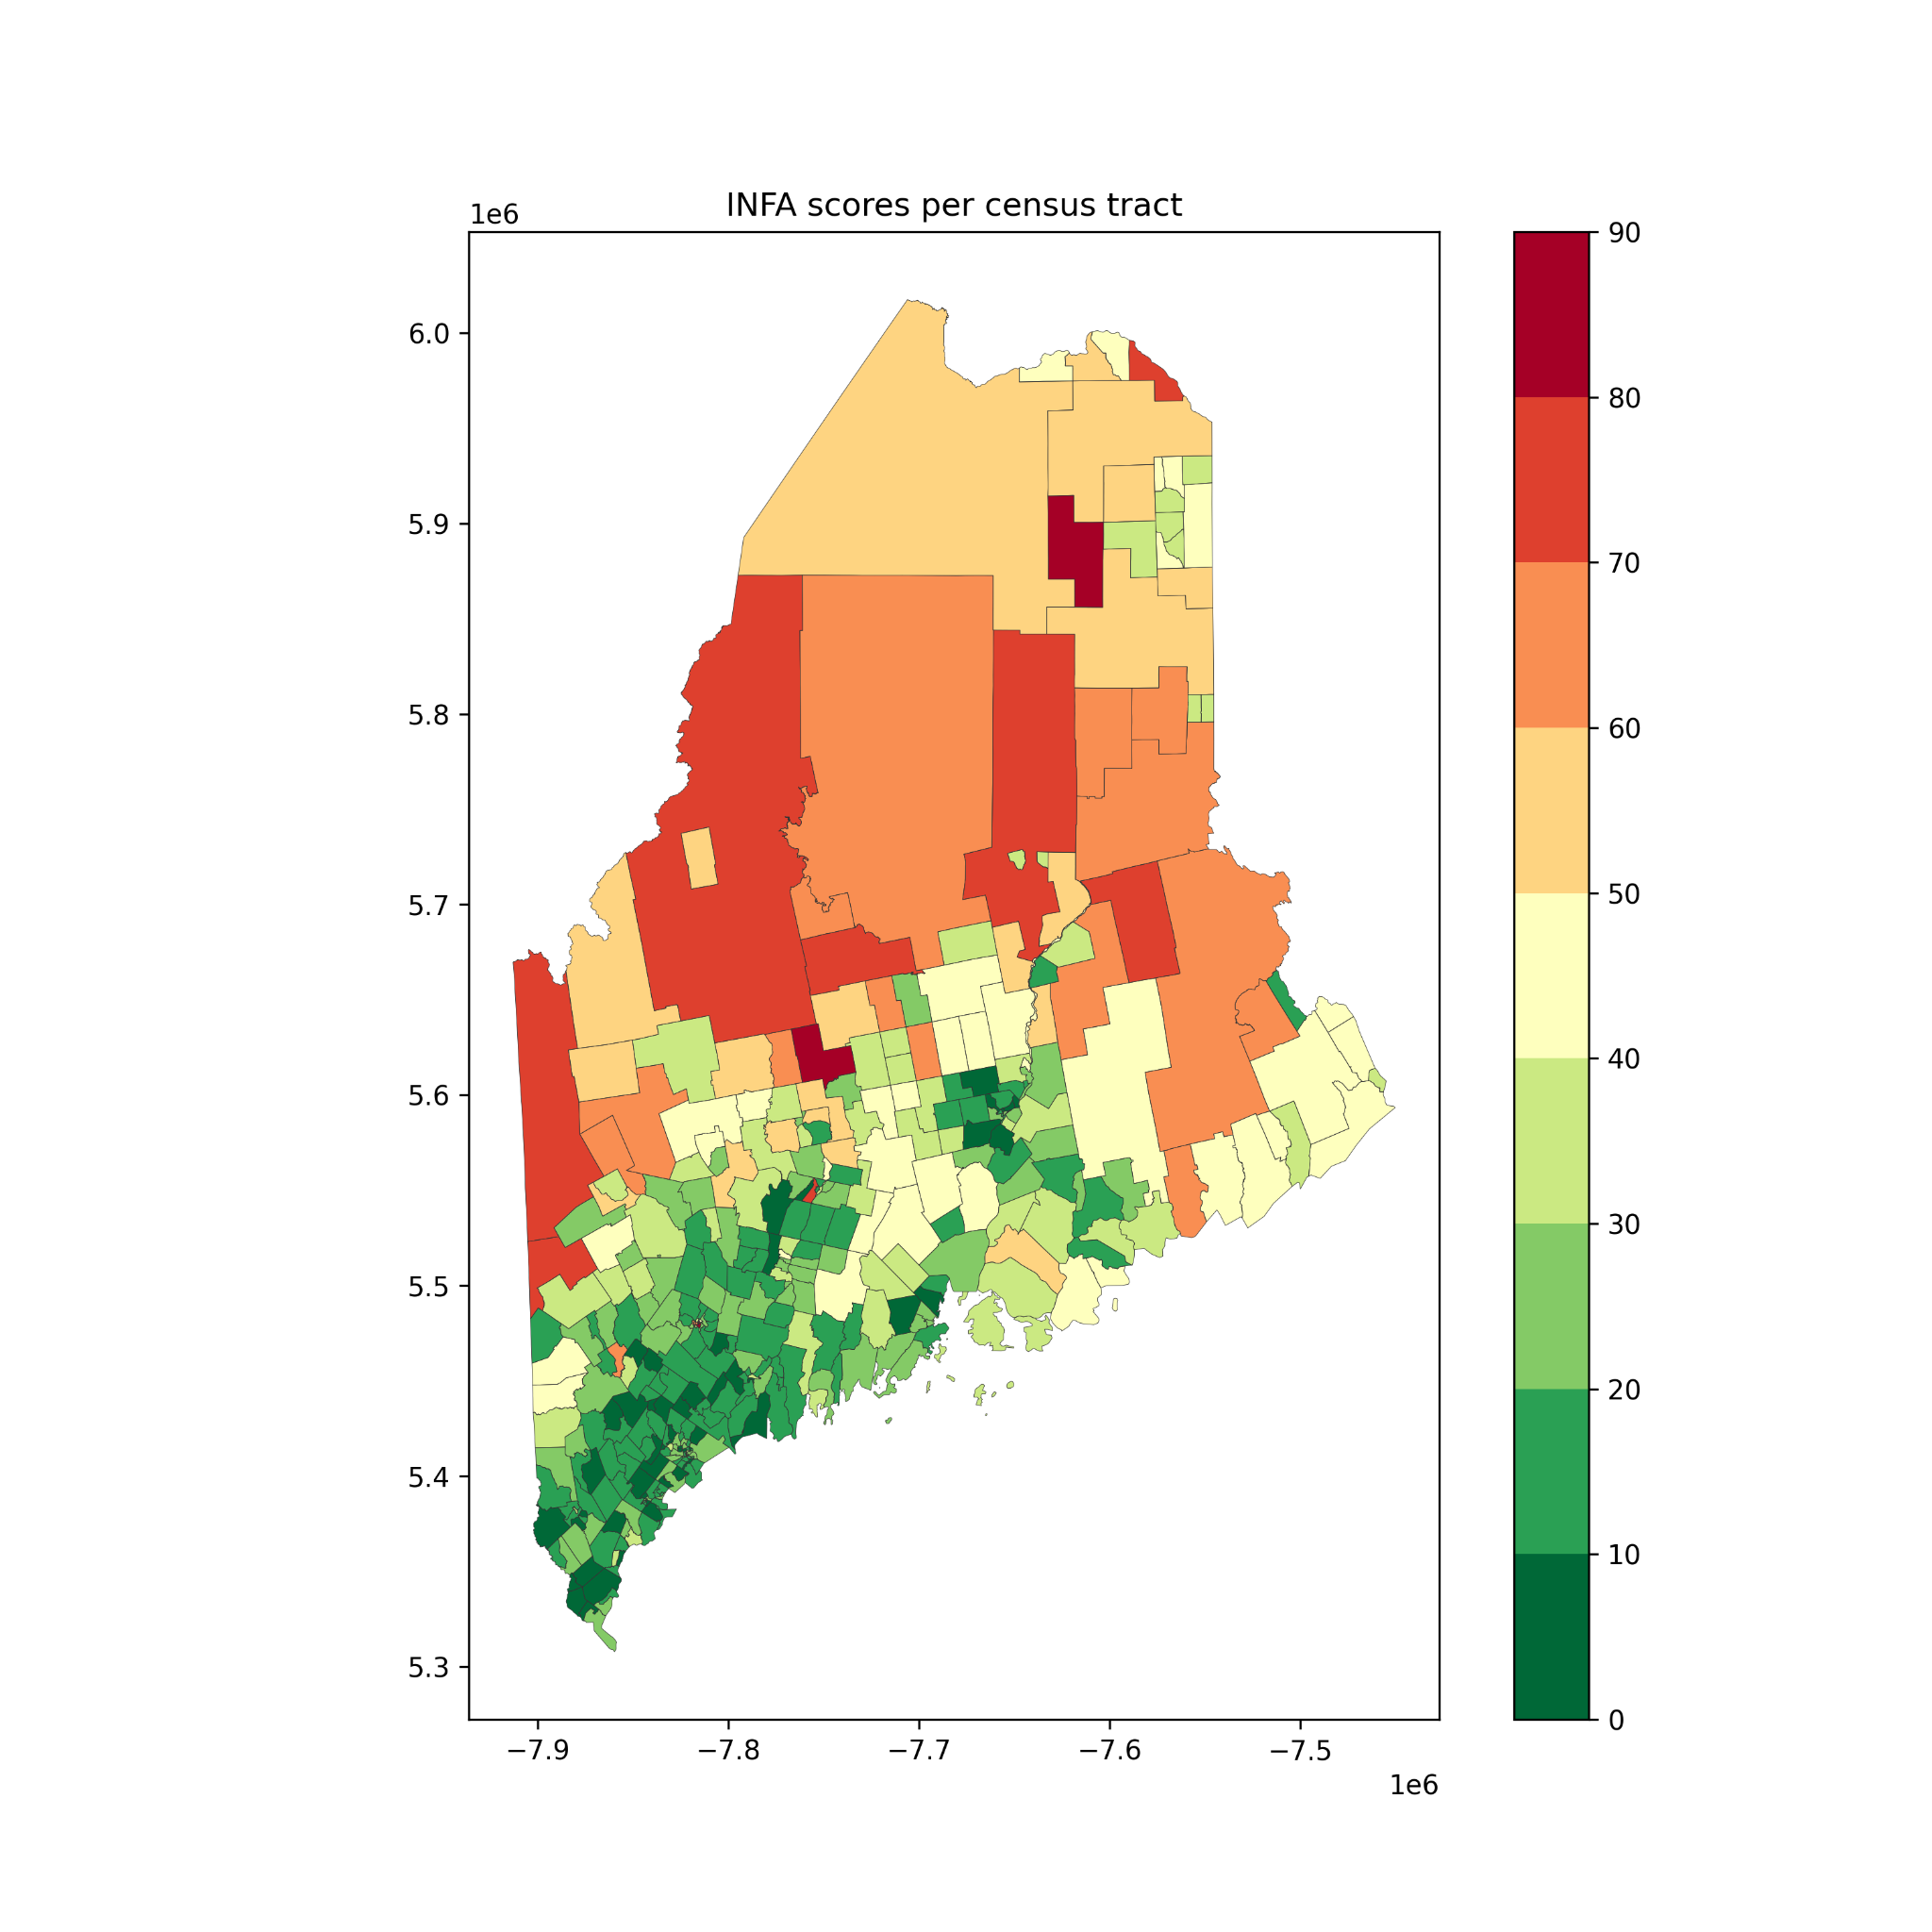
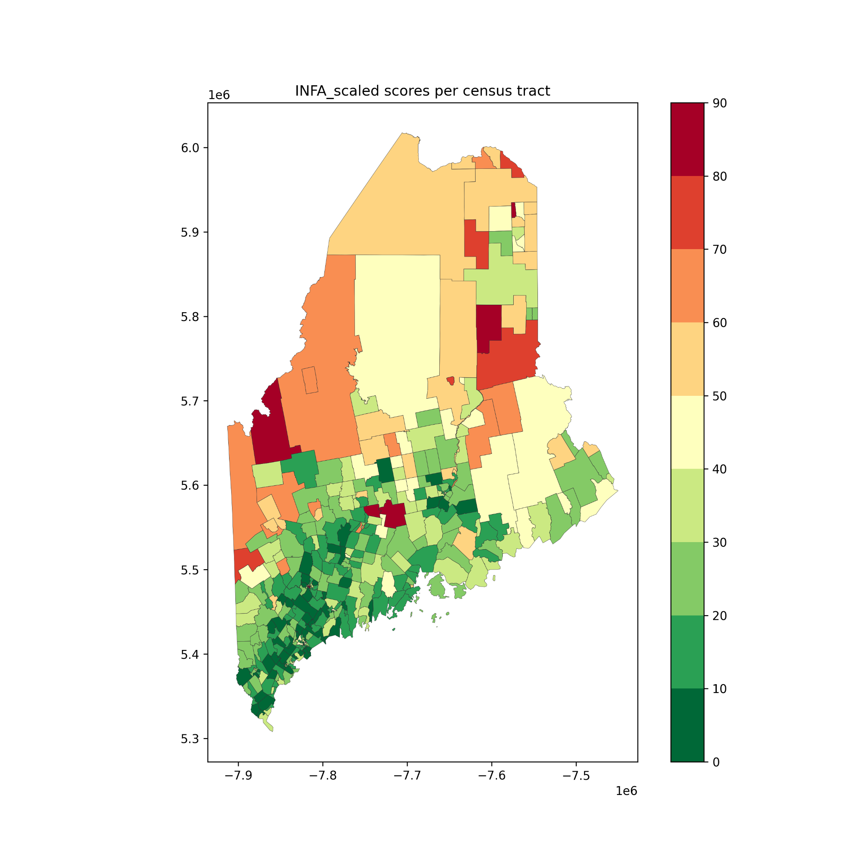
2023 spring
2024 spring

Slide 6
SE
SE: Socioecnomic = AGE60 + INCAR + VET + DIS + MIN + RURAL + LANG + POV
* AGE60: z-scores of the percent of population with age over 60
* INCAR: z-scores of the percent of incarcerated individuals
* VET: z-scores of the percent of veterans
* DIS: z-scores of the percent of population with disabilities

Slide 7
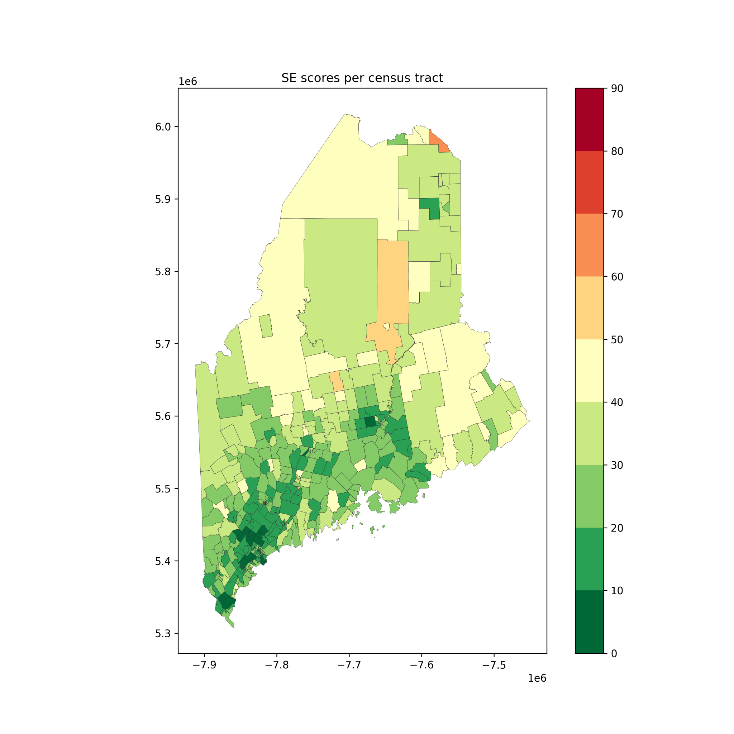
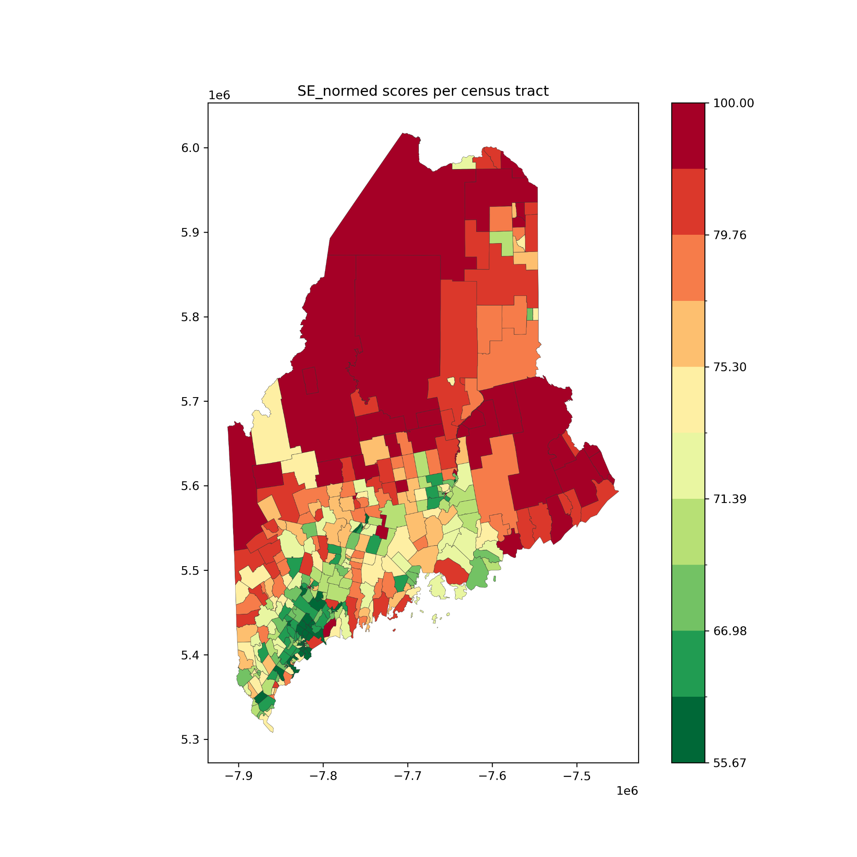
2023 spring
2024 spring
The SE component includes more socioeconomic factors, leading to the notable difference.

Slide 8
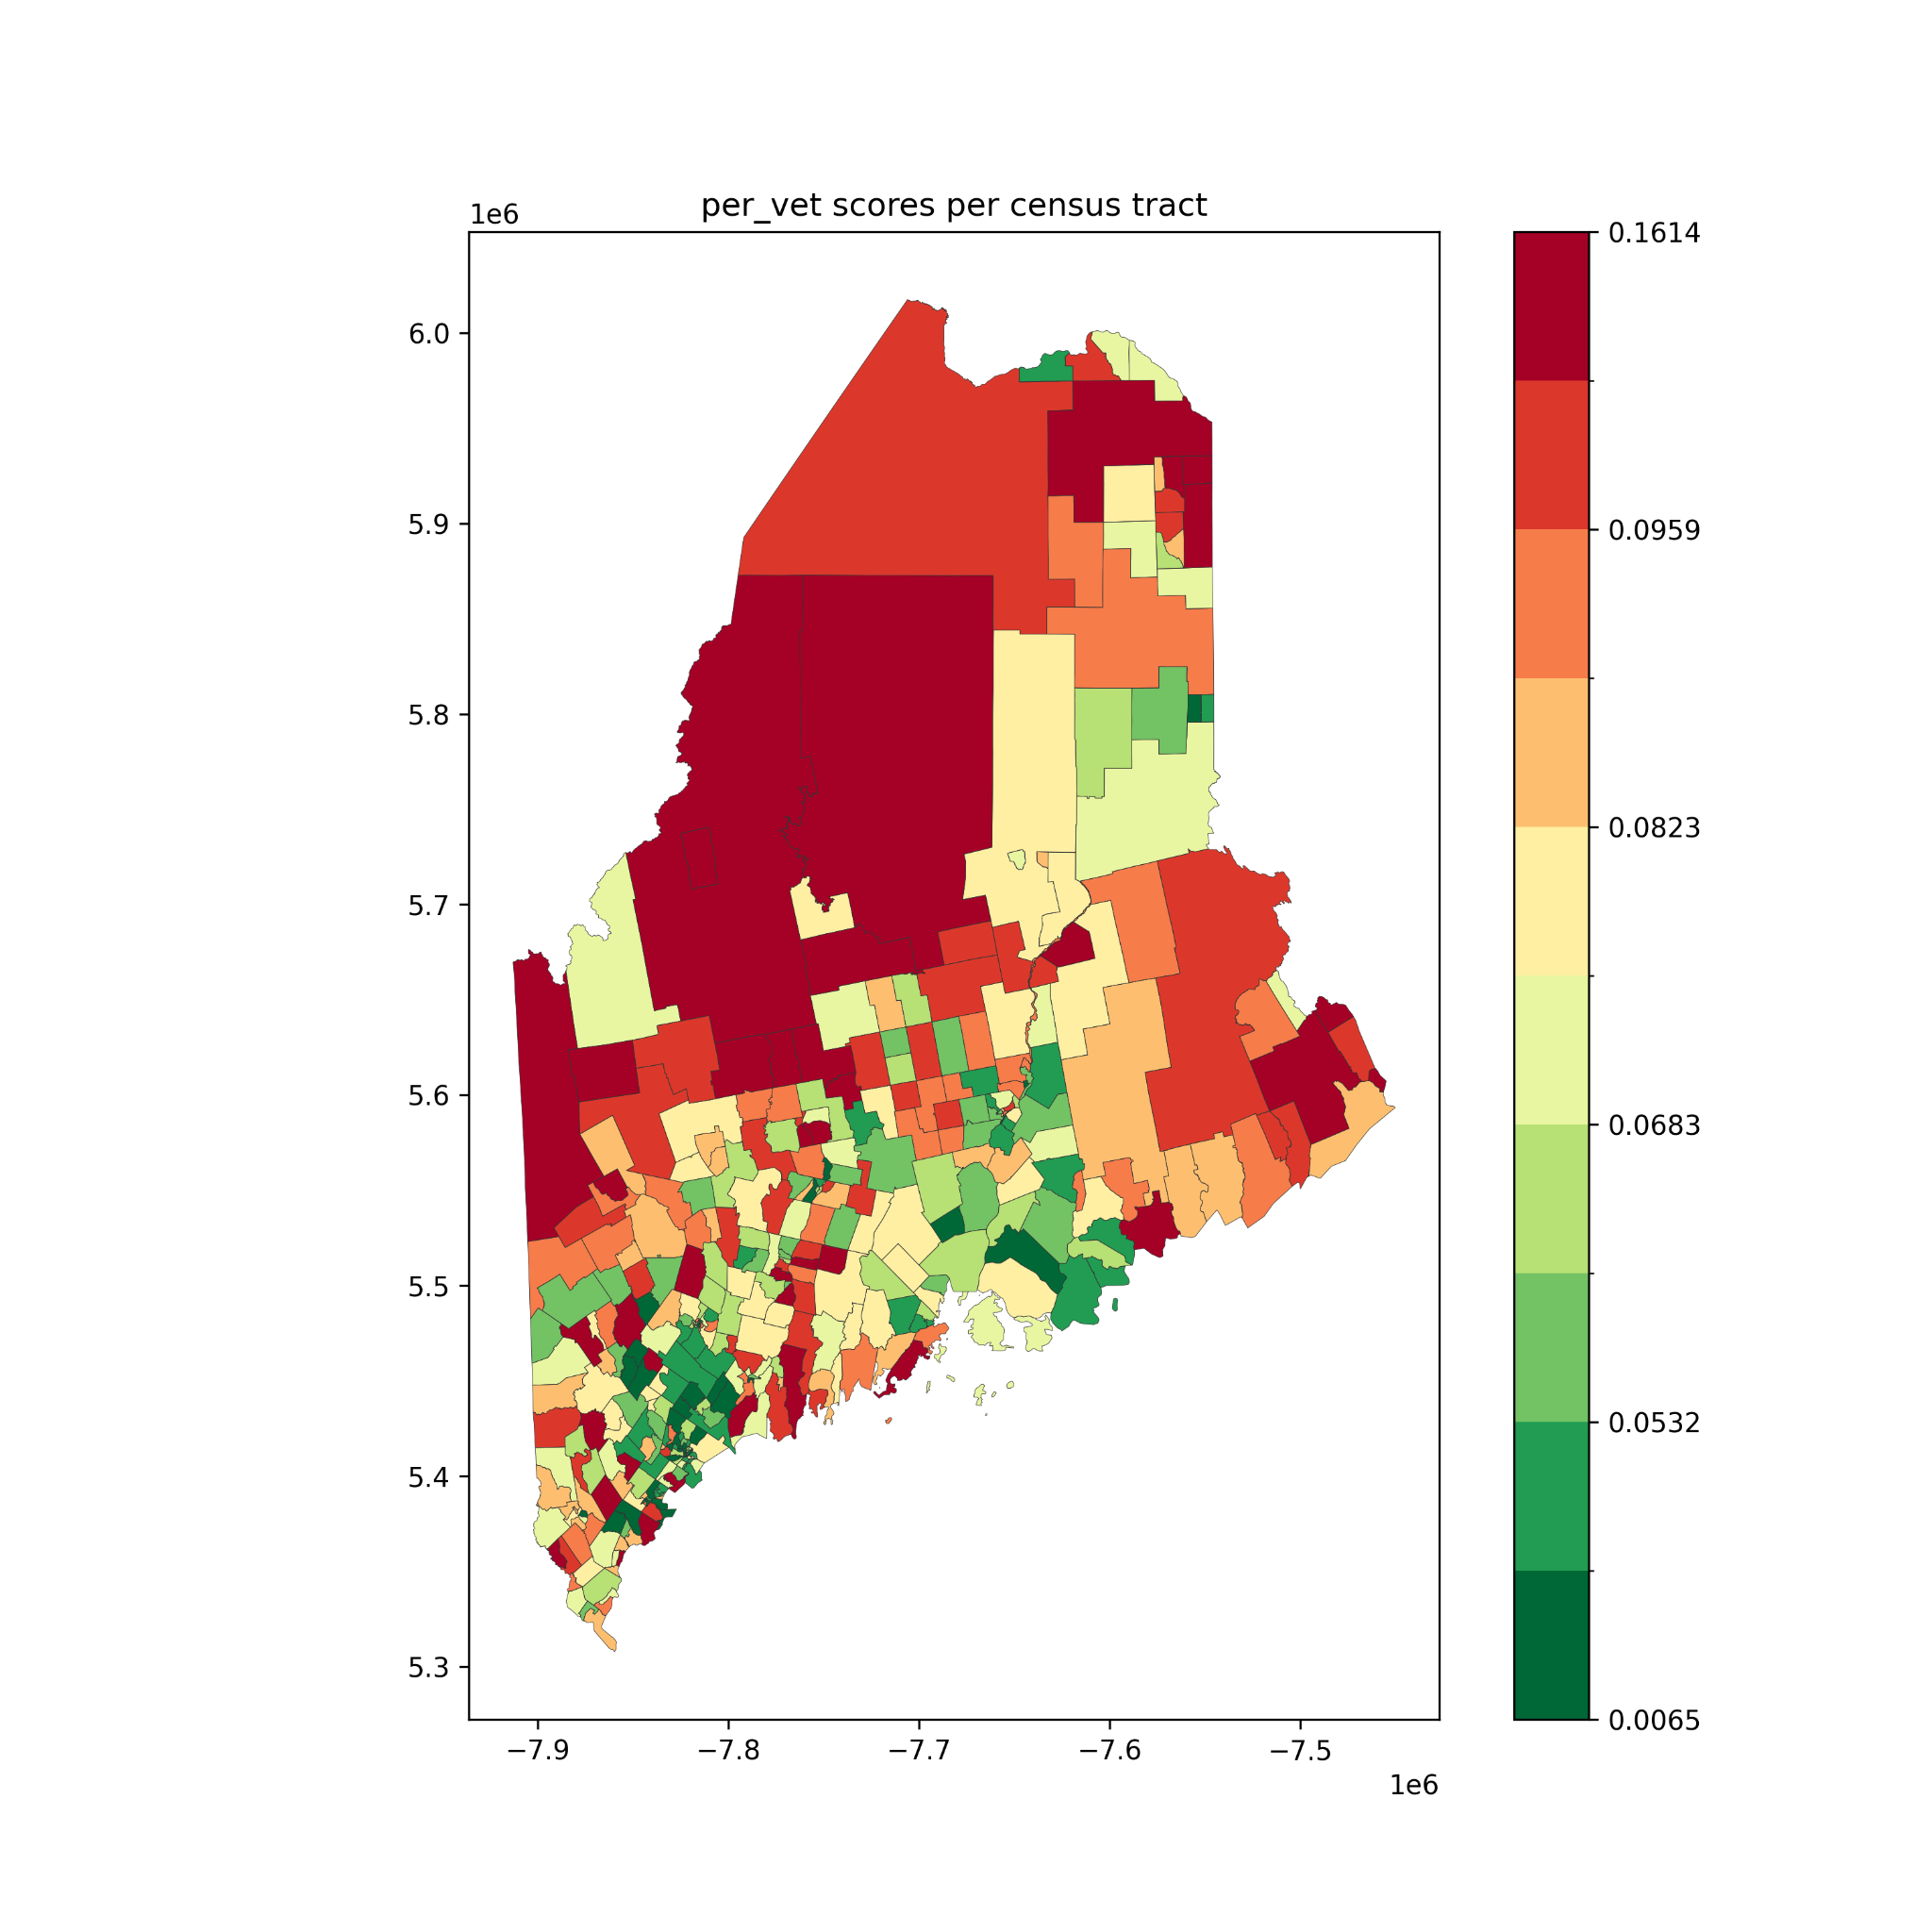
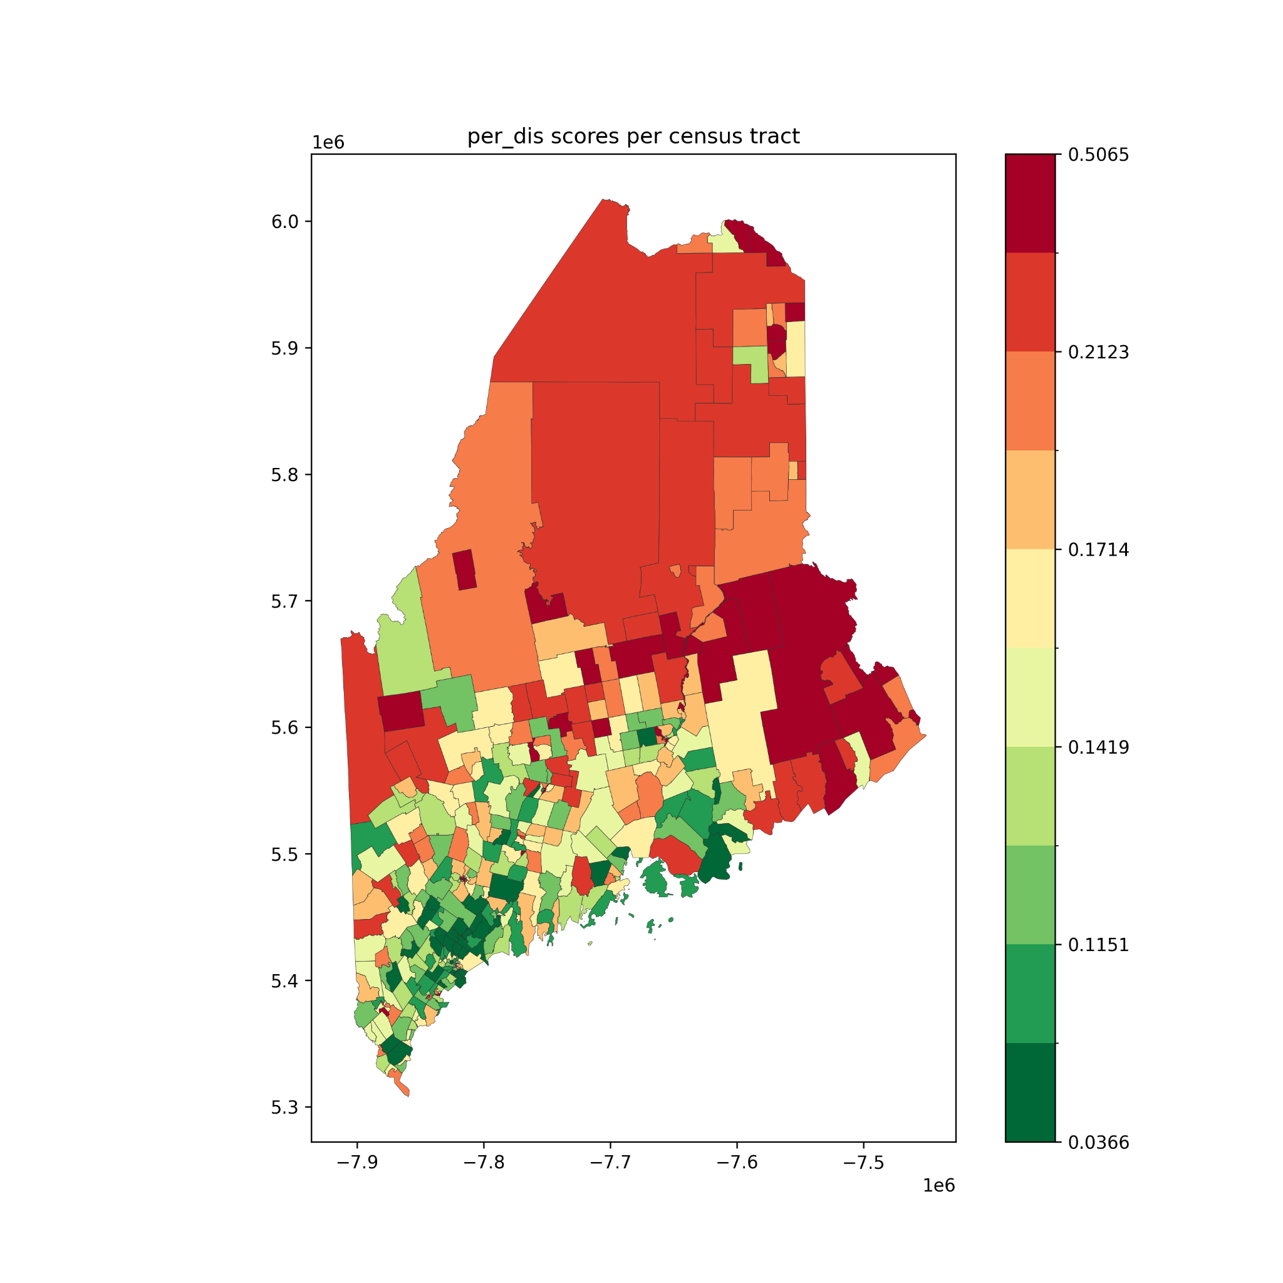
VET & DIS
Left:
Veterans
Right:
Disabilities

Slide 9
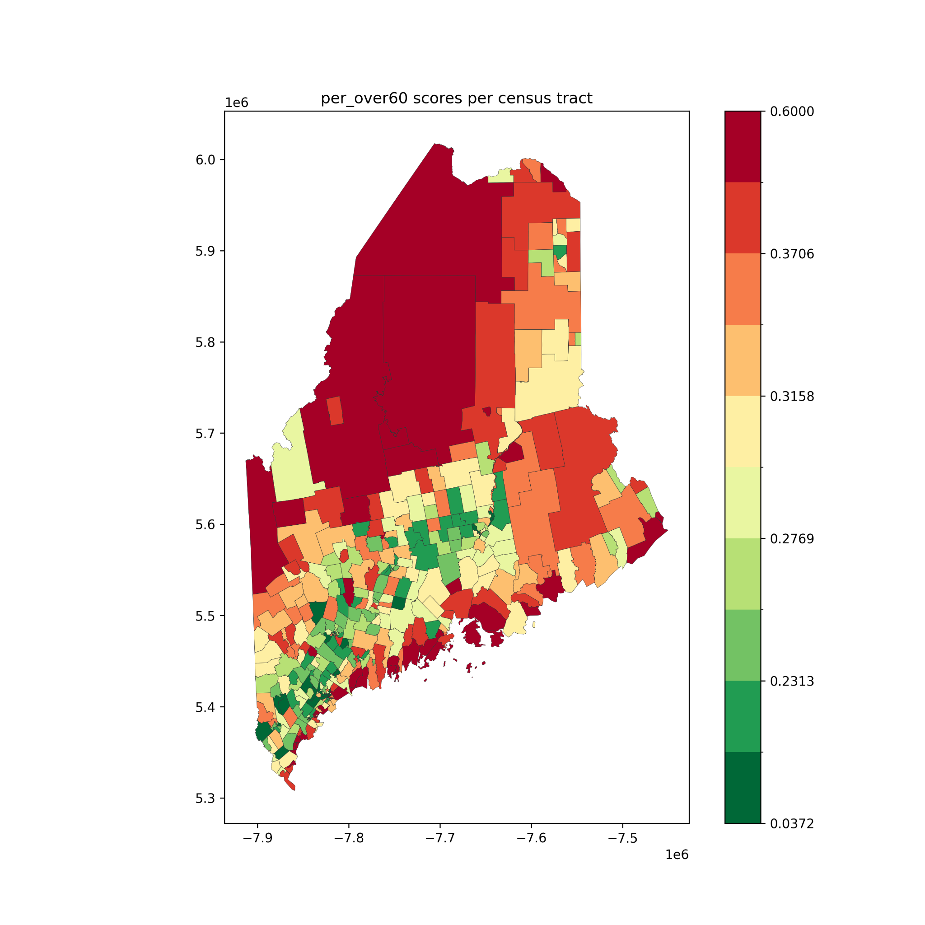
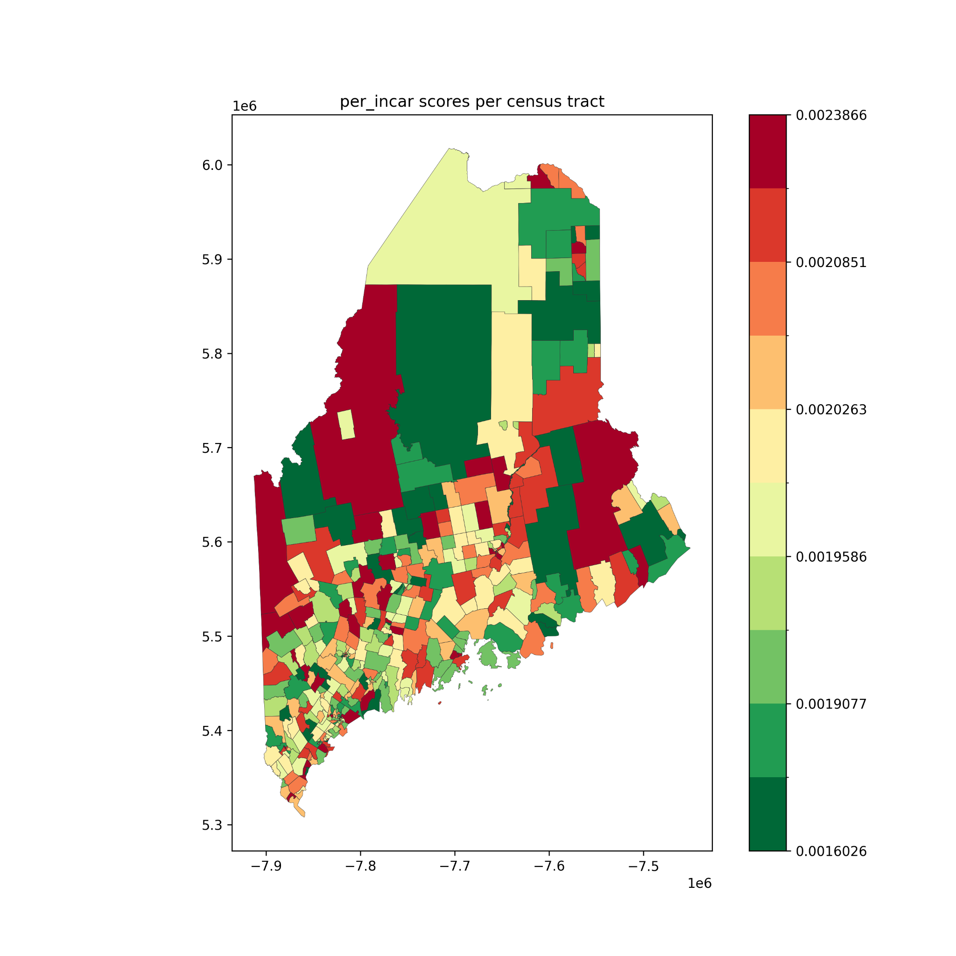
AGE 60 &
INCAR
Left:
Population over 60
Right:
Incarcerated individuals

Slide 10
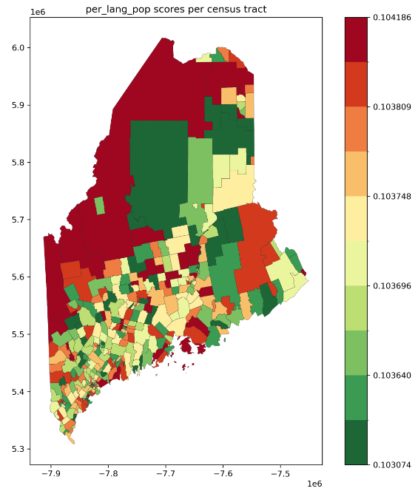
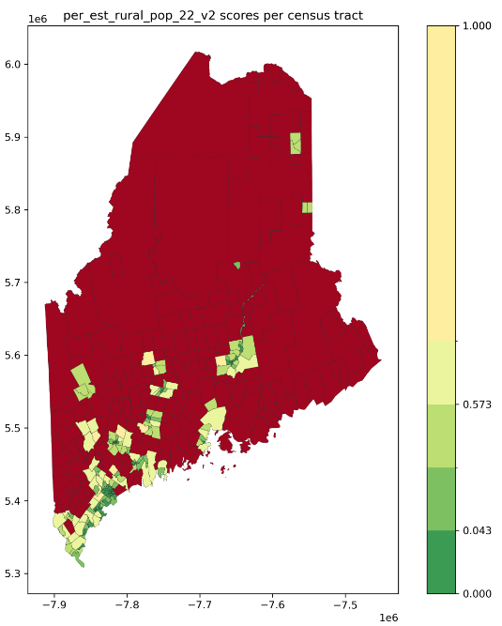
Rural & Lang
People with language barriers
Rural residents
Both populations are calculated through estimation. (inaccuracy)
Rural/urban label is assigned to each block (geograph) -> Some census tracts include only rural residents

Slide 11
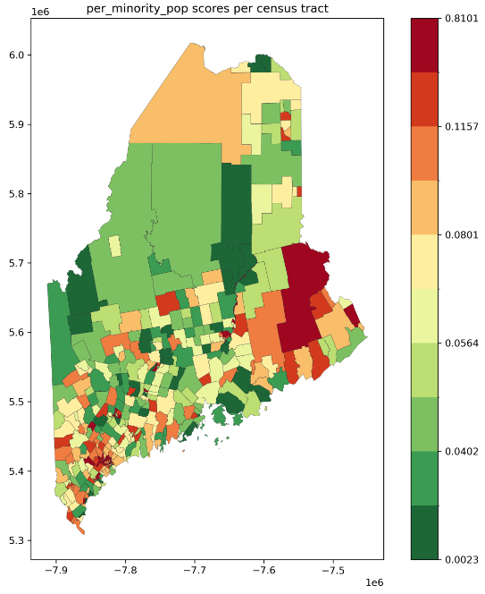
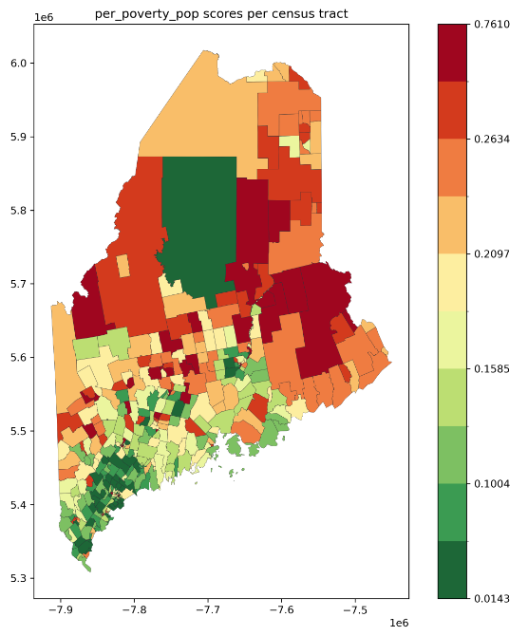
Poverty & Minority
Minority population
Poverty population
Minority population are concentrated in urban centers.
The distribution of poverty population might reflect the economic development.

Slide 12
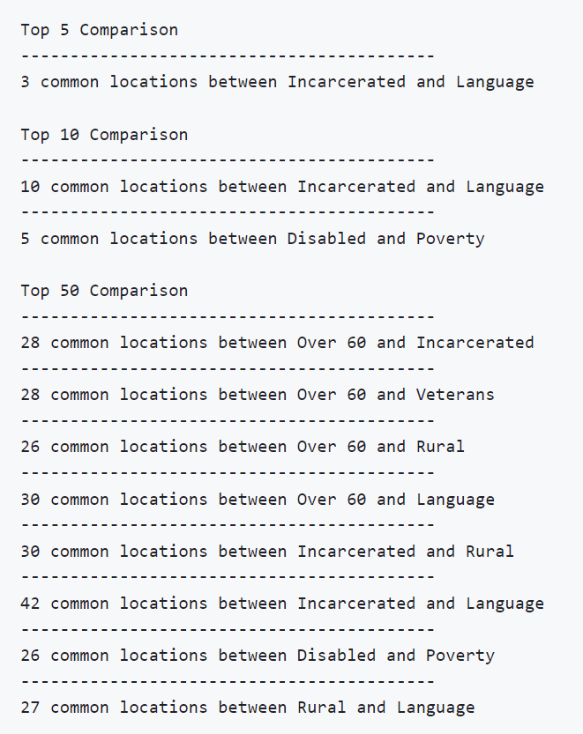
Analysis (Top N census tracts list for SE factors )
Method: examination of the top-ranking areas across various SE factors
Identify census tracts consistently shown in multiple lists (threshold: overlaps exceed half the length of each list)
Goal: identify the specific issues in areas and guide the type of supports.
Incarcerated and Language - shown in top 5/10/50
Similar method used in estimating these population
Disabled and Poverty - shown in top 10/50
Disabled population and people with low-income are both concentrated in these locations.
Possible correlation between these two factors

Slide 13
Next Step
Solve the challenges faced when calculating the scores
Inaccurate data (language barrier, incarcerated, rural) should be modified by collecting more reliable data and using more advanced estimation techniques.
Validation step should be added to evaluate the data and results.
Missing census tracts should be analyzed to understand the reason.
Conduct more comprehensive analysis
Comparisons between factors in each census tract can identify the most important issues in the specific census tract -> inform more targeted resource allocation
The possible correlation between factors can be investigated.
Improve the front-facing interface
Static maps can only show the overall distribution; therefore, using an interactive table and map to explore data can be more effective.

